Slide 1
Technical Activities Division (TAD) Spring Business Meeting 17 May 2026
POC: Lesley Weitz, TAD Chief
lweitz@mitre.org

Slide 2
Agenda
Sunday, May 17, 2026, 1-5 PM ET, Washington Hilton
Topic | Start Time | Duration (min) | Topic | Speaker
1 | 1:00 | 5 | Agenda and Review of SciTech Meeting Minutes | Weitz
2 | 1:05 | 10 | TAD Chief’s Report | Weitz
3 | 1:15 | 10 | TAD Chief Transition and New Chief’s Vision | Mange
4 | 1:25 | 10 | AIAA Director’s Report | Lagana
5 | 1:35 | 10 | FIS Report | Azevedo
6 | 1:45 | 10 | TIS Report | Smith
7 | 1:55 | 10 | Defense WG Report | McEver
8 | 2:15 | 20 | SMG TC Change Proposal | Blanchette
9 | 2:35 | 15 | Publications Updates | O’Connor
10 | 2:50 | 10 | CTO Summit Overview and TAD Involvement | Weitz/Lagana
11 | 3:00 | 10 | Update on IT Upgrades and Survey Results | Lagana
 | 3:10 | 15 | Break
12 | 3:25 | 70 | Director Roundtable | All
13 | 4:35 | 5 | Broken Sword Award | Beresh
14 | 4:40 | 10 | Actions and Closing | Weitz

Slide 3
Fall Meeting Minutes - UPDATE
Note: we are behind on Meeting Minutes from the Summer and November TAD meetings. We will aim to complete them before the Spring Business Meetings.

Slide 4
TAD Chief’s Report
Lesley Weitz (lweitz@mitre.org)

Slide 5
Technical Activities Division Org Chart
Lesley Weitz – Chief, Technical Activities Division
Staff Liaison: Michael Lagana
AEROSPACE DESIGN AND STRUCTURES GROUP
Dawn Phillips, Director
Vladimir Balabanov – Dep Dir for Cross-Institute Coordination
Steve Arnold – Deputy Director for Forum Coordination
Walt Silva – Deputy Director for TC Coordination
Jeff Kaufmann – Deputy Director for TC Coordination (Jan. 2026)
Vinay Goyal – Deputy Director for Forum Coordination (Jan. 2026)
Adaptive Structures – Jeff Kauffman
Design Engineering – Jessica Widrick
Materials – Evan Pineda
Multidisciplinary Design Optimization – Mike Henson
Non-Deterministic Approaches – Gianluca Geraci
Spacecraft Structures – Manan Arya
Structural Dynamics – Anubhav Datta
Structures – Scott Norwood
Survivability – Adam Goss
Systems Engineering – Mat French
INFORMATION SYSTEMS GROUP
Michel D. Ingham, Director
Misty Davies – Deputy Director for Intra-Group Collaboration
John Valasek – Deputy Director for Cross-Group Coordination
Daniel “Dani” Selva – Deputy Director for Forums
Natasha Neogi – Deputy Director for Forums
Jimmie McEver – Deputy Director for Defense
Jim Paunicka – Deputy Director, TIS
Communications Systems – Rob Singh
Computer Systems – Christopher Coley
Digital Avionics – Mark Darnell
Human-Machine Teaming – Terry Morris
Information and Command and Control Systems – Ali Raz
Intelligent Systems – Justin Bradley
Sensor Systems and Information Fusion – Nick Napoli
Software – Umut Durak
AIRCRAFT TECHNOLOGY, INTEGRATION, AND OPERATIONS GROUP
David Maroney, Director
Phillip Ansell – Dep Dir for Cross-Institute Coordination
David Levy – Deputy Director for Forums
Scot Campbell – Deputy Director for Aircraft Operations
Aerospace Lifecycle Management – James Chou
Aircraft Operations – Gabriele Enea
Air Transportation Systems – Min Xue
Flight Testing – Cody Hydrick
Danielle Soban– Deputy Director for Aircraft Technologies
Aerodynamic Decelerator Systems – Aaron Morris
Aircraft Design – Douglas Wells
Balloon Systems – Javier Romualdez
Electrified Aircraft Technology – Gökçin Çınar
General Aviation – Matt Crink
HyTASP – Hicham Alkandry
Lighter-Than-Air Systems – Michael Conners
V/STOL Aircraft Systems – Marcus McWaters
TAD Liaisons
Ethics Committee – Jeff Hamstra
Honors & Awards – Jim Guglielmo
Publications – Wayne Hurwitz
Standards – Ron Kohl
Public Policy Liaisons
Steve Broussard, ADSG
Crystal Pasiliao, ASG
Phillip Ansell, ATIO Rep
Jimmie McEver, ISG Rep
Mirko Gamba, PEG Rep
Kenneth Lui, SMG Rep
Technical Integration Subcommittee (TIS)
Vladimir Balabanov, Chair
Steve Beresh, ASG Rep
Phillip Ansell, ATIO Rep
Jim Paunicka, ISG Rep
Tom Smith, PEG Rep
Ron Kohl, SMG Rep
AEROSPACE SCIENCES GROUP
Martiqua Post, Director
Joao Luiz Azevedo – Deputy Director for Forum Coordination
Brian Freno– Deputy Director for Disruptive Engagement
Crystal Pasiliao – Deputy Director for TC Engagement
Chris Cotting – Deputy Director for Strategic Planning and Initiatives
Aeroacoustics – Clifford Brown
Aerodynamic Measurement Technology – Amy Fagan
Applied Aerodynamics – Mehdi Ghoreyshi
Astrodynamics – Kyle DeMars
Atmospheric and Space Environments – Charlie Zheng
Atmospheric Flight Mechanics – Jared Grauer
Fluid Dynamics – Manan Vyas
Fluid Instability and Transition – Tom Corke
Ground Testing – Chris Jorgens
Guidance, Navigation and Control – Joseph Connolly
Meshing, Visualization & Computational Environments – Ryan Durscher
Modeling and Simulation – Scott Kowalchuk
Plasmadynamics and Lasers – Albina Tropina
Thermophysics – Kevin Weed
PROPULSION AND ENERGY GROUP
Rusty Powell, Director
Stephanie Sawhill – Deputy Director for Forum Coordination
Wayne Hurwitz – Deputy Director at Large and Operations
Stephen Lynch, Deputy Director for Air Breathing Propulsion
Gas Turbine Engines - Veeraraghava Raju Hasti
High Speed Air Breathing Propulsion – Bob Moehlenkamp
Inlets, Nozzles, and Propulsion Systems Integration – Stefanie Hirt
Pressure Gain Combustion – Donald Ferguson
Kurt Polzin – Dep Dir for Rocket, Space & Advanced Propulsion
Electric Propulsion – Kristina Lemmer
Energetic Components and Systems – Jim Baglini, Jr.
Hybrid Rockets – Trevor Elliott
Liquid Propulsion – Nathan Andrews
Nuclear and Future Flight Propulsion – Greg Meholic
Propellants and Combustion – Adam Steinberg
Solid Rockets – Barbara Lakota
Ashwani Gupta – Deputy Director for Energy
Aerospace Power Systems – Jeremiah McNatt
Terrestrial Energy Systems – Tarek Abdel-Salam
SPACE AND MISSILES GROUP
Stephen Blanchette, Director
Karen D. Barker – Deputy Director
Ron Kohl – Deputy Director
Dustin Otten – Deputy Director
Tim Wadhams – Deputy Director
Life Sciences and Systems – Christopher Nie
Gravity Dependent Science and Technology – Kenneth Lui
Missile Systems – Brandon Chynoweth
Reusable Launch Vehicles – Amrutur Anilkumar
Small Satellite – Shannon Statham
Space Architecture – Georgi Petrov
Space Automation and Robotics – Samantha Chapin
Space Settlement – Robert Noteboom
Space Logistics – Paul Grogan
Space Operations and Support – Sweety Pate
Space Resources – Bob Moses
Space Systems – John Carsten
Space Tethers – Eleonora Botta
Space Transportation – TBD
Weapon System Effectiveness – Nick Mueschke
Forums Integration Subcommittee (FIS)
Joao Luiz Azevedo, Chair
Steve Arnold, ADSG Rep
David Levy, ATIO Rep
Dani Selva, ISG Rep
Stephanie Sawhill, PEG Rep
Dustin Otten, SMG Rep
Last updated Jan 6, 2026
5

Slide 6
TAD Chief Transition and New Chief’s Vision
Rick Mange (lweitz@mitre.org)

Slide 7
TBD
TBD

Slide 8
AIAA Director’s Report
Michael Lagana

Slide 9
Forums Integration Subcommittee (FIS) Report
Joao Azevedo (joaoluiz.azevedo@gmail.com)

Slide 10
Technical Integration Subcommittee (TIS) Report
Tom Smith

Slide 11
TIS Spring 2026
Established Monthly meeting rhythm
Came up with six tasks for TIS
1. Establish the “General TC Guideline”
2. Monitor the progress of the TC Charter Refresh
3. Standardize and Automate Annual Compilation of TC Health Metrics
4. Work with TCs to communicate to them the important aspects
5. Capture Emerging Technologies and Trends
6. Create TIS server space and collect TIS documents
7. Get familiar with what IOD doing and how it relates to TIS

Slide 12
1. Establish the “General TC Guideline”
Tom Smith agreed this action
Michael Lagana noted that the existing TC Chair’s Manual needs updating
The idea is to make one TC Manual that the TCs are encouraged to adopt
Some TCs like Structures has its own General TC Guideline
Some processes are not uniform between the TCs
For instance, MDO TC elects a Vice Chair who automatically becomes the next Chair. Not all TCs do it this way.
We would use the TC Chair Exit Interview process to obtain suggested modifications to the guideline by the outgoing chair.
Tom has sent a marked up TC Chair Manual to Lesley and Mike. The ball is in their court.

Slide 13
2. Monitor the progress of the TC Charter Refresh
Jim Puanicka agreed this action
The TIS members all prodded the TC chairs in their respective Groups.
Some Chairs responded with their Charter.
Some are pleading for more time
Mike Lagana has allowed an extension to the May time frame.
TIS May review the charters for adherence to the TC Guidelines. This requires the TC Guideline to be done first. It also requires the Charters to be in first.
Mike has the numbers on how many TCs have responded with Charters

Slide 14
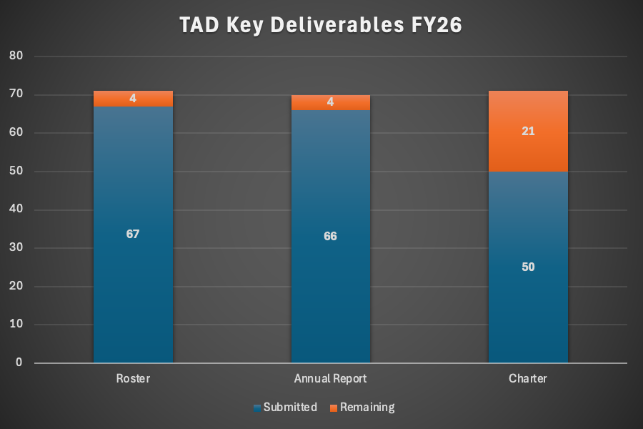
Key Deliverables Submissions*
*Fluid Instability and Transition was not required to submit an annual report; Space Transportation is classified inactive and has not been included as part of this data call.
Notes:
TAD Deliverables are tracking well. Very good showing from TCs.
Rosters are 94% complete
Annual Reports are 94% complete, with one TC (Fluid Instability and Transition) not required to submit because they were chartered in November last year.
Charters are 70% complete. Group Directors are reviewing charters and approving/workshopping them with the committees.

Slide 15
3. Standardize and Automate Annual Compilation of TC Health Metrics
Vladimir Balabanov agreed to lead this one
Standardize and Automate Annual Compilation of TC Health Metrics
Get familiar with the current process, data storage, accessibility, etc. Utilize previous health assessment and annual reports. Work closely with Michael Lagana. Upcoming AIAA database may cause some evolvement.
Discuss with AIAA proposed improvements and automation. Implement agreed improvements and automation.
Mike spoke of our server and IT. We will migrate from NetForum to Altai Systems in order to consolidate more. Should help with this particular task. The switch has planned for 4th Qtr or later.
Can start with the TC annual reports. They are due today, Feb 27, 2026
Vlad says Angie compiled some data in Excel
Peter Hartwich sent Mike a document on this from IOD

Slide 16
4. Work with TCs to communicate to them the important aspects of leadership flowdown
Mike Lagana Volunteered. Matches his current activities anyway
Ongoing: Work with TCs to communicate to them the important aspects of: - Mike
TAD Director’s Roundtable
TAD Leadership Positions
TAD Exec mtg agenda/summary, CoD mtg summary.
Compile Documentation on TAD Leadership Positions. Follow-up Actions from AIAA CTO Summit on AI Applications
Collect TC’s response and proposals and communicate that to TAD and Directors. Work closely with Michael Lagana and his monthly committee newsletter.

Slide 17
5. Capture Emerging Technologies and Trends
Ron Kohl, Phil Ansell and Brian Freno agreed to cover the three Domains Space, Aviation and R&D and Defense respectively
Avoids confusion and cross-talk across TCs and IOCs when new topics emerge (where does a topic "fit" and how can we co-sponsor across groups?).
Ensures we are keeping a pulse on new, high-impact developments and not missing opportunities to expand what AIAA has to offer to the aerospace community.
Converge on what is the problem we are trying to solve
Could start by building the ETT list. Many inputs, TC surveys, CTO summit, AIAA LLM search
Bounce list off the TCs buckets and see which technologies are not addressed by any TCs. Flag these are gaps.
Groundrule – Use this list to maintain the value of AIAA vs. other societies like SAE
Will share compiled list with Domains leads, TCs, ICs, etc.
Could share list with Domain leads. Domains are in charge of future thinking for the institute. Ryan Patrick, R&D is aware of our ETT activity but has not reached out to us yet.
Could share with the Corporate Advisory Board as well.
Ultimate goal is to comb the technologies and see if they fit in existing TCs or warrant a new TC, working group, IC, Panel Session

Slide 18
6. Create TIS server space and collect TIS documents
Mike Lagana will do this
Mike started an AIAA Google Drive
https://drive.google.com/drive/folders/1qVzgT3BEHDCNVJVptEkWIKRvNFBesXLk?usp=drive_link
Ron said at the TAD meetings there was an AIAA IT update plan that includes solving the issue of a common data repository. This is coming from the AIAA CIO.

Slide 19
7. Get familiar with what IOD doing and how it relates to TIS
Vladimir and Ron volunteered for this one
The IOD redesign is happening. An update at the next IOD meeting at Aviation Monday at 10:30.
IOD meeting April 2. IOD will be presented with the redesign results

Slide 20
New Business April 28
Ron found some ETTs not captured by TCs
In Space Disaster Management
In Space Health Care
Ron has introduced these to his Space Settlement TC. The TC vice chair happens to be a space nurse. She took on Space Health Care and created a subcommittee to address it.
Ron has taken on Space Disaster Management. No progress so far. Could be a subcommittee. Could evolve into a TC or IC. Building it as a Community of Interest.
Ron points out that the focus on Technology oriented TCs versus capability-oriented groups is somewhat of a gap for AIAA. Maybe make ICs more capability-oriented.
Brian has started a computational physics community. There was a meeting in Feb with great turnout. Will have a SciTech 2027 session. Will have a meeting at Aviation. Goal is to evolve it into a TC. Getting traction in TAD, with CFD standards group and others.
Next meeting at Aviation on Wednesday. Moving at the expected pace.
One new TC in progress. One ETT taken on. One ETT in limbo.

Slide 21
Defense Working Group Report
Jimmie McEver

Slide 22
Re-envisioning SMG’s Space TCs January 2026 Update to TAD
Stephen Blanchette Jr. (stephen.blanchette@aero.org)

Slide 23
Publications Committee Update
Jackie O’Connor

Slide 24
CTO Summit Overview and TAD Involvement
Lesley Weitz & Michael Lagana

Slide 25
Update on IT Upgrades and Survey Results
Michael Lagana

Slide 26
15-Minute Break

Slide 27
Director Roundtable
Michael Lagana

Slide 28
Director Roundtable
Proposed Format: Group-focused discussions (each director presents individually)
Top-3 priorities in 2026-2027 term
What is working well? What are your pain points?
What are ways AIAA staff can support you? Tools? Streamlining processes?
10-minutes per group with 10 minutes (total) for intro/closing = 70 minutes

Slide 29
Director Roundtable Stephen Blanchette – Space and Missiles Group
17 May 2026
stephen.blanchette@aero.org

Slide 30
SMG Director’s Priorities – 2026
Complete the refresh of our space-related TCs
Continue improving TC connections to planning for SciTech, DEFENSE, and, especially, ASCEND
Succession planning for next SMG Director (2029-2031)
Have been sounding out/encouraging past TC chairs
Have been dropping hints at every TC meeting I’ve attended
Want at least two viable candidates
30
30

Slide 31
Looking Back, Then Charging Ahead
Fantastic participation and collaboration across the board on space TC refresh effort
Terrific enthusiasm from TC Leadership for moving forward in our new construct
Super collegial relationship with AIED Chief, TAD Chief, and fellow Directors
Can’t say enough good things about AIAA Staff – super supportive!
AIAA IT infrastructure still a challenge
Too much manual effort to keep up with TC leadership changes and contact information
Where else in TAD do we need to consider a refresh?
What’s the right cadence and process for continually keeping TAD (and AIED) relevant?
31
31

Slide 32
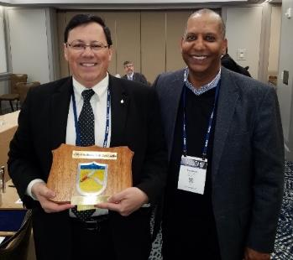
TAD Broken Sword Award History
Thanks to Emily Springer and Jim Keenan for helping recall award history
Award originated decades ago based on vehement arguments and members willing to “fall on their sword” to win the battle… now, more for fun and team bonding
Award recognizes the best (or worst!) verbal gaffe, sarcastic remark or illogical conclusion made during the TAD meeting
Renamed in 2018 to honor many-time winner Tony Gross
Award presented by prior recipient
Plaque to be proudly displayed in recipient’s home office
TAD community, both Volunteers & Staff, qualify for honor
Terry Morris presents the Broken Sword Award to winner Dimitri Mavris at SciTech 2020

Slide 33
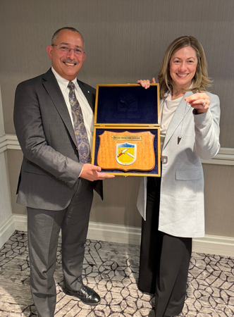
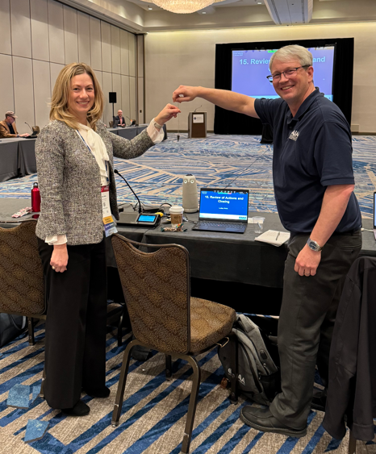
Broken Sword Award
Lesley Weitz
January 2025
Lesley Weitz
July 2025
Stephen Blanchette
April 2025

Slide 34
Review of Actions and Closing
Lesley Weitz, TAD Chief
Michael Lagana, Technical and Integration Communities, AIAA

